Slide 1
LSTM Modeling of Upper Mississippi River-Illinois Waterway System for Predictive Dredging Operations Problem Definition and Planning
Barrie Chileen Martinez
barrie.v.chileenmartinez@usace.army.mil

Slide 2
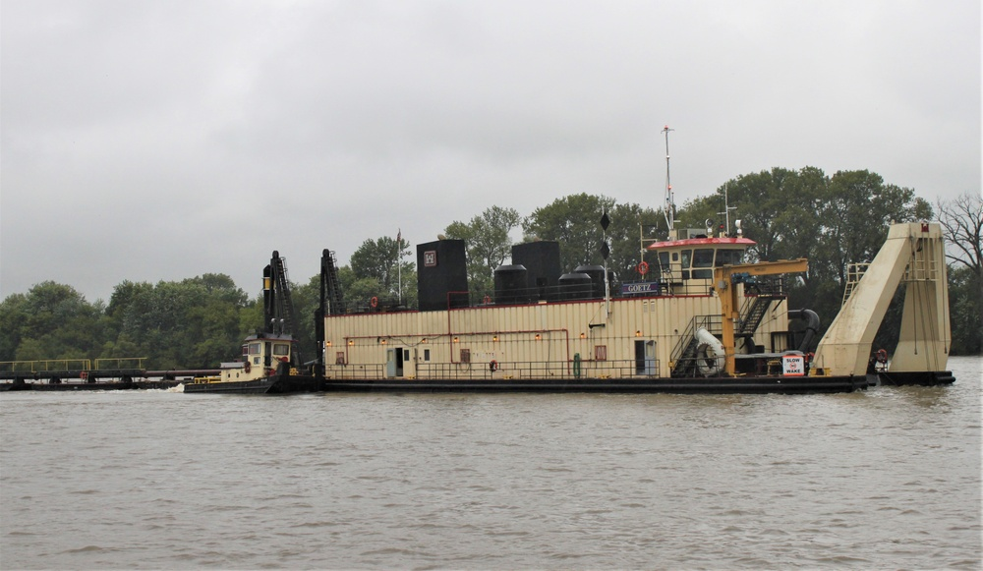
Introduction
Navigation is primary mission for USACE Rock Island District
Manages 314 miles of the Mississippi River and 268 miles on the Illinois Waterway
9-foot channel depth maintained for commerce and recreation

Slide 3
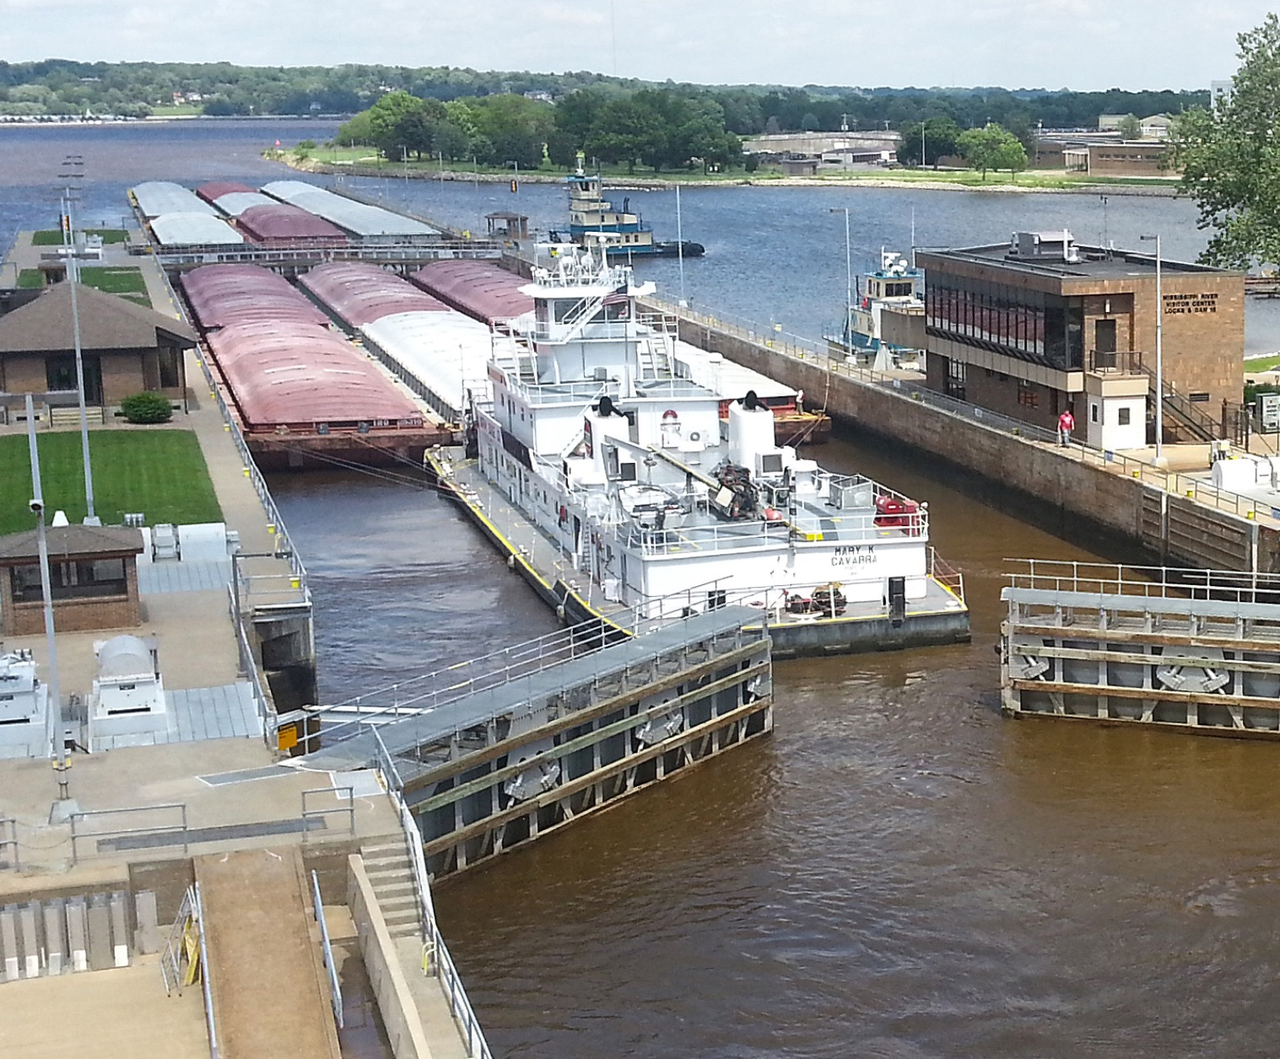
Business Use Case
Business problem: Dredging operations are currently reactive, making it difficult to coordinate resources efficiently and leads to increased costs and potential commerce delays.
Key Question: Can predictive modeling based on historic dredging and shoaling data enable proactive resource management and reduce operational costs?
Industry Impact:
Over 90 million tons of cargo transported annually through the system
Vessel groundings can shut down the waterway
Channel restrictions cost hundreds of thousands of dollars per day in delayed commerce
Reactive maintenance creates inefficient resource allocation

Slide 4
Success Criteria
Objectives:
Clean and integrate river gage, dredging, and hydrosurvey datasets
Identify key predictive features through PCA and xGBoost analysis
Train and validate LSTM and CNN models for shoaling prediction
Compare models using MAE (<15%), RMSE, precision/recall (>85%)
Develop mapping and visualization products
Outcomes:
Predictive model integrating river gage observations and forecasts
Achieve a 70% precision in predicting shoaling rates at increments of both 14 days and 21 days
Extend operational dredging forecast from days to biweekly outlooks.
Deliver mapping tools that enable proactive dredge plant coordination

Slide 5







Data Sources, Tools, and Models
Data Sources:
USACE Hydrographic Surveys from eHydro
River Gage forecasts from NOAA and RiverGages.com
Shoaling Rates from Corps Shoaling Analysis Tool
Historic dredge records
Tools:
Code – R, Python
Packages – Tidyverse, Caret, R Shiny
Libraries – Tensorflow, PyTorch, Pandas
Software – ArcGIS Pro
Models: Principal Components Analysis (PCA)
Extreme Gradient Boosting (xGBoost)
Long-Short Term Memory (LSTM)
Convolutional Neural Networks (CNN)

Slide 6
Time and Constraints
Time: Expected final deliverable by December 8, 2025
Constraints:
Historic dredging and survey records may be incomplete
Dredging is a relatively low occurrence compared to survey frequency
LSTM and CNN models may require significant compute resources
Modeling two different river system may require multiple models
Final product needs to be usable and interpretable by general audience

Slide 7
Project Plan & Timeline
Three Key Phases:
Phase 1 – Data wrangling and exploration
Phase 2 – Model Development and analysis
Phase 3 – Assessment and Synthesis
Phase and Activities | September | October | November | December
Phase 1 Data Preparation – Gather data, conduct data quality assessment
Phase 1 Exploratory Data Analysis – Feature selection through PCA and xGBoost
Phase 2 LSTM Development – Build model and format data for LSTM Modeling
Phase 2 CNN Development – Build model and format data for CNN Modeling
Mid-Project Stakeholder Presentation
Phase 2 Model Training and Validation - Train and Validate LSTM and CNN Models
Phase 3 Assess model performance - Compare LSTM and CNN model
Phase 3 Complete Capstone - Develop final deliverables and create visualizations
9/2-9/22
9/16-9/30
9/30-10/20
10/14-11/3
10/14
10/15-11/17
10/27-11/17
11/18-12/8

Slide 8
Risk Assessment

